Slide 1
Ecommerce Sales Dashboard
POWER BI PROJECT
Detailed analysis of sales, profit, margin and orders
Prepared by [Your name] · [Date]
Notes:
Welcome. This deck walks through the Ecommerce Sales Dashboard in detail: the data, the KPIs, each dashboard visual, insights, recommendations and a conclusion.

Slide 2
Agenda
1
Project introduction
5
Deep dive
What the project is about
Region, category, product and customer segment
2
Project objectives
6
Insights and recommendations
What we set out to do
What we found and what to do next
3
Data model and dashboard
7
Conclusion
Tables and the two report pages
Summary of the project
4
KPI analysis
Sales, profit, margin and orders
Notes:
Outline of the presentation.

Slide 3
Project Introduction
This project analyses an ecommerce business using Power BI. The dashboard brings customers, orders, order items, products and categories into one data model, so sales, profit and order performance can be tracked in a single view.
The dashboard shows
Sales and profit trend over time
Sales by region and customer segment
Sales by category and top products
Orders by status and payment method
Notes:
Introduce the business context and the data behind the dashboard.

Slide 4
Project Objectives
Track overall performance
Measure profitability
Monitor total sales, total profit and total orders in one place.
Understand profit margin and average order value.
Find top performers
Understand customers and orders
Compare regions, categories and products by sales.
Analyse customer segments, order status and payment methods.
Notes:
Four objectives: track performance, measure profitability, find top performers, understand customers and orders.

Slide 5
Data Model
Customers
Orders
OrderItems
Products
Categories
Region
Customer segment
Order status
Payment method
Total Sales
Total Profit
Profit Margin %
Total Orders
Average Order Value
Product name
Category name
Every KPI is a measure on OrderItems, so each chart can be filtered by customer, order, product or category.
Notes:
Five related tables feed the dashboard. Measures are calculated on OrderItems and sliced by the other tables.

Slide 6
Dashboard Overview
Page 1: Orders overview
Page 2: Sales dashboard
Cards for sales, profit, margin, orders and average order value
Total orders chart
Order status by payment method
Region slicer
Sales vs profit trend
Sales by region, category, segment and product
Orders by status
Notes:
The report has two pages: an orders overview and a sales dashboard.

Slide 7
KPI Analysis
Total Sales
Total Profit
Profit Margin
Total Orders
₹[8.49M]
₹[3.75M]
[44.17]%
[1.8k]
Revenue from all order items
Earnings after costs
Total profit as a share of total sales
Number of orders placed
Key takeaway
[Summarise what the four KPIs show together, for example whether strong sales are also turning into healthy profit.]
Notes:
Replace the bracketed values with the numbers from your dashboard cards.

Slide 8
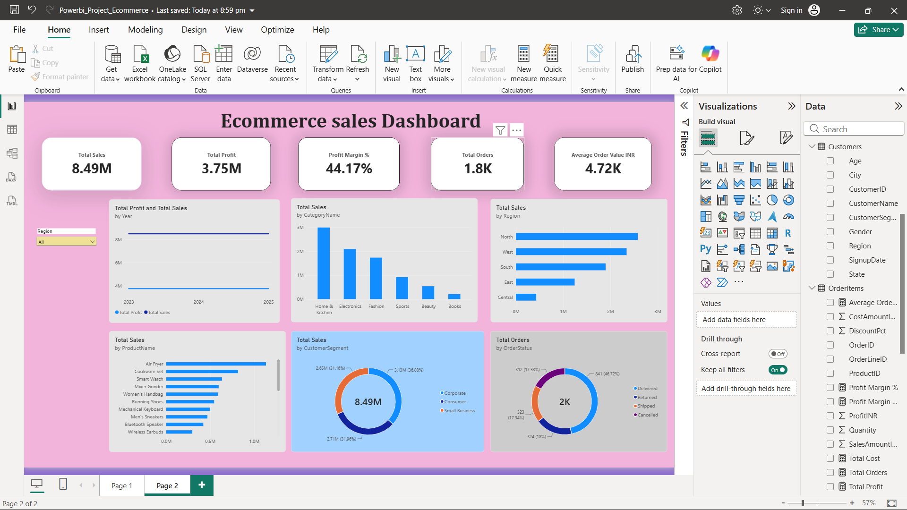
Total Sales
Paste dashboard screenshot here
Total Sales card and Sales vs Profit trend (line chart)
What it shows
Total sales and total profit plotted together over time, so growth and seasonality are easy to compare.
Insights
[Peak period and growth trend]
[How profit moves with sales]
Notes:
Paste the Total Sales card and the line chart. Fill in the two insights.

Slide 9
Total Profit and Profit Margin
Paste dashboard screenshot here
Total Profit and Profit Margin % cards
What it shows
Profit after costs, and the share of each sale the business keeps as profit.
Insights
[Margin level and what drives it]
[Where margin is weakest]
Notes:
Paste the profit and margin cards. Explain what is pulling margin up or down.

Slide 10
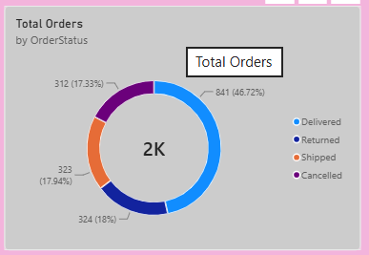
Total Orders
What it shows
Paste dashboard screenshot here
Total Orders, Average Order Value and Orders by status / payment method
How many orders were placed, the average order value, and how orders split by status and payment method.
Insights
[Order volume and average order value]
[Share of non-completed orders]
Notes:
Paste the orders cards and the order status by payment method chart.

Slide 11
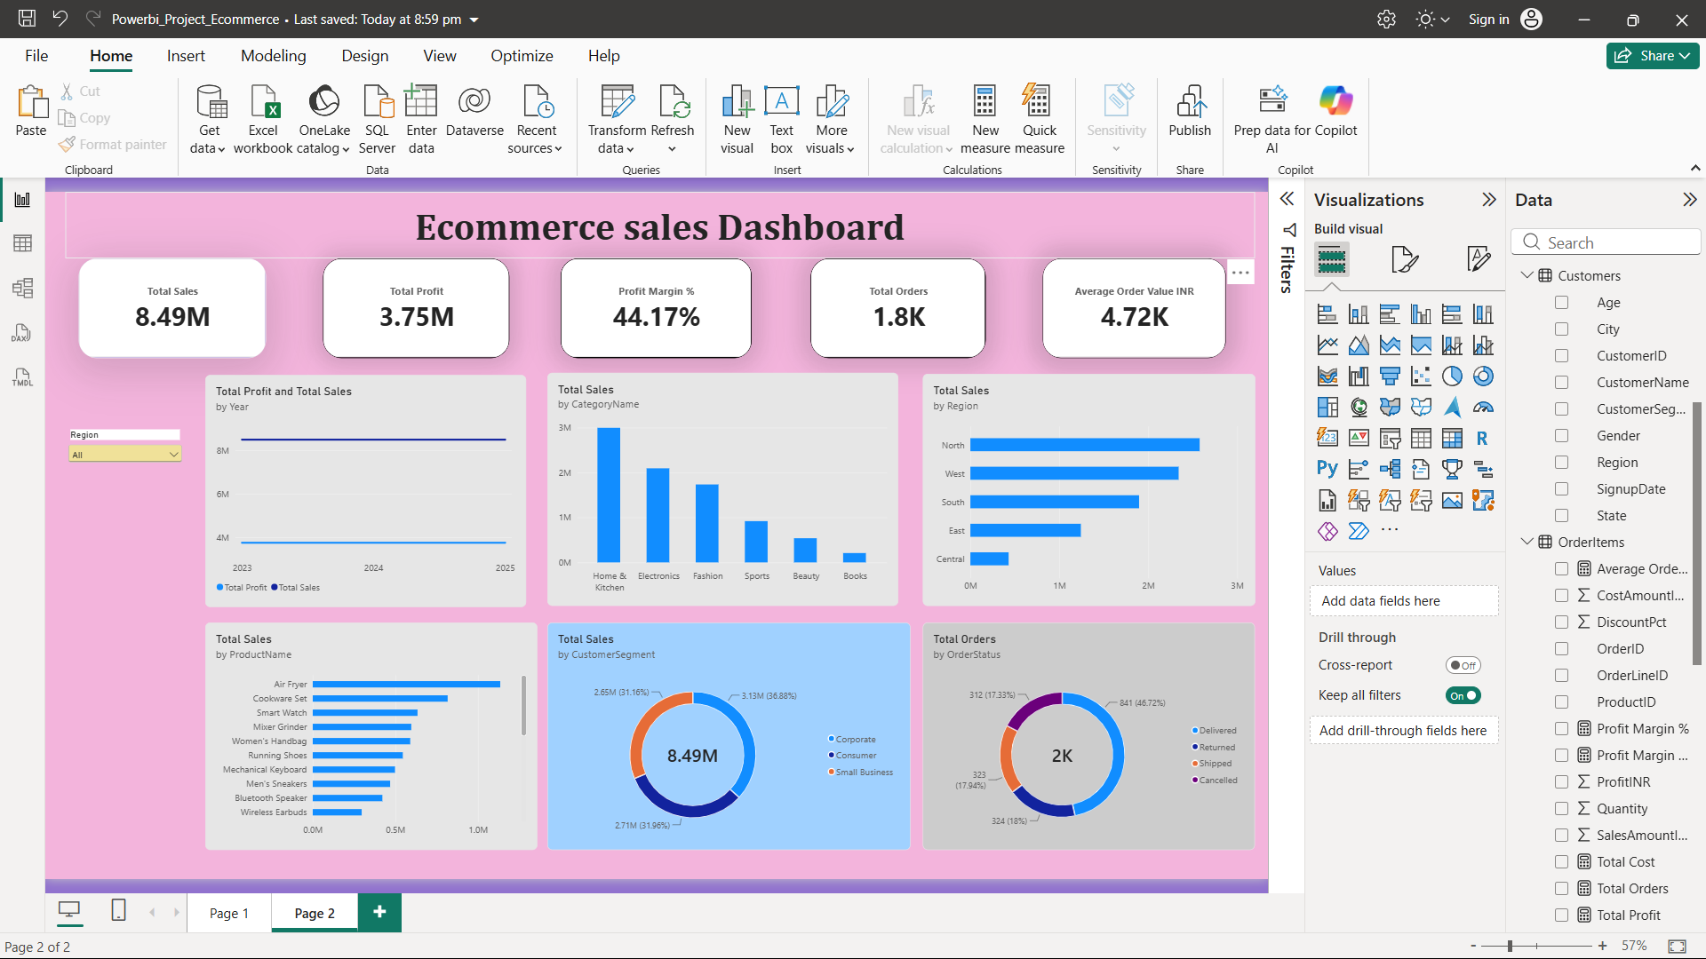
Sales by Region
Paste dashboard screenshot here
Sales by Region (bar chart) with the Region slicer
What it shows
Total sales for each customer region, with a slicer to focus on one region.
Insights
[Top region and its share of sales]
[Weakest region]
Notes:
Paste the regional bar chart.

Slide 12
Sales by Category and Product
Paste dashboard screenshot here
Sales by Category (column) and Sales by Product (bar)
What it shows
Which categories and products bring in the most sales.
Insights
[Leading category]
[Top products and how concentrated sales are]
Notes:
Paste the category and product charts.

Slide 13
Sales by Customer Segment
Paste dashboard screenshot here
Sales by Customer Segment (donut chart)
What it shows
How total sales divide across customer segments.
Insights
[Largest segment and its share]
[Segment with room to grow]
Notes:
Paste the customer segment donut chart.

Slide 14
Key Insights
Sales
Profitability
[Top region and category drive most of the sales]
[Profit margin is __% and is strongest in __]
Customers
Orders
[__ is the largest customer segment]
[__% of orders are not completed]
Notes:
Fill each card with one finding from the dashboard.

Slide 15
Recommendations
1
Back the best-selling categories
Increase stock and marketing for [top category], the leading source of sales.
2
Lift the profit margin
Review pricing, discounts and supplier costs on low-margin products.
3
Grow the weaker regions
Run targeted campaigns in [lowest-selling region], where sales trail the rest.
4
Reduce order drop-off
Study non-completed orders in the order status chart and improve fulfilment and payment options.
5
Nurture key customer segments
Build loyalty offers for [top segment] and test campaigns for the others.
Notes:
Fill the bracketed names from the dashboard.

Slide 16
Conclusion
The Power BI dashboard gives one clear view of sales, profit, margin and orders. With total sales of ₹[__] and a profit margin of [__]%, [describe how the business is performing].
Acting on the recommendations will strengthen both growth and profitability.
Notes:
Close by restating the headline numbers and the main actions.

